Slide 1
Green Space
15-01-2016 | GEO1005
Rob Braggaar (4159047) - IJsbrand Groeneveld (4412877) - Brenda Olsen (4149556)

Slide 2
15-01-2016 | GEO1005
Introduction
Green space is vital for environmental, social well-being and public health reasons.
Green areas should be available to all citizens
The program has two use cases:
- Planning tool for urban planners
- Information for the citizen

Slide 3
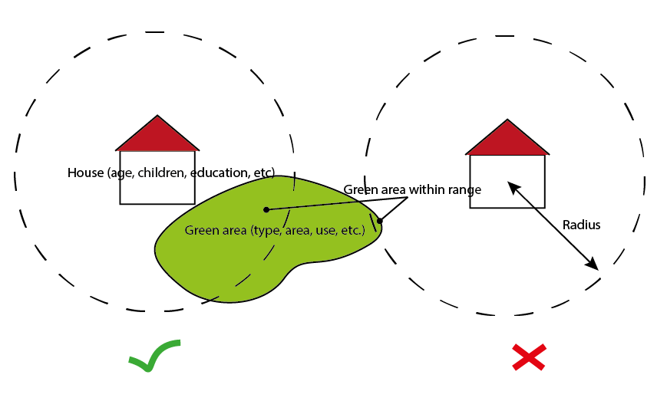
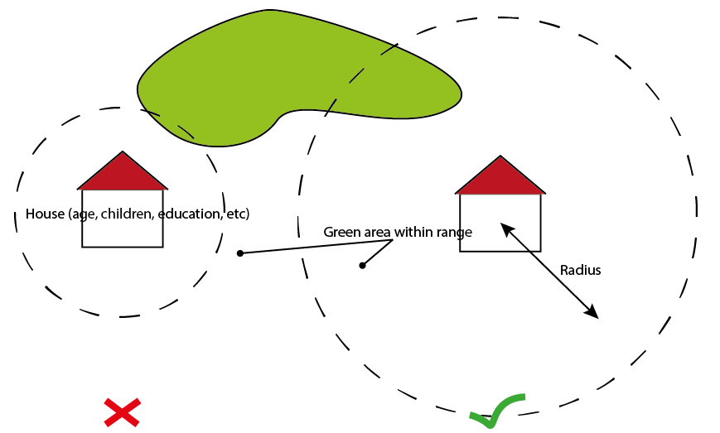
15-01-2016 | GEO1005
Concept

Slide 4
15-01-2016 | GEO1005
1) The plugin as a planning tool
Tool may be used to indicate areas of attention
Parameters to be set by the planner
The planner evaluates the end results and decides if action needs to be taken
Different municipalities may have different thresholds for the amounts of green space

Slide 5
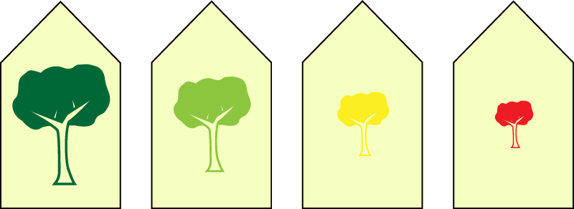
15-01-2016 | GEO1005
2) The plugin as a citizen’s tool
Future house owners may want to know the quality of the neighbourhood before purchasing a new house
Much like the energy labels we introduce a new label:
The Green Label:

Slide 6
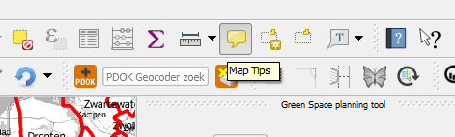
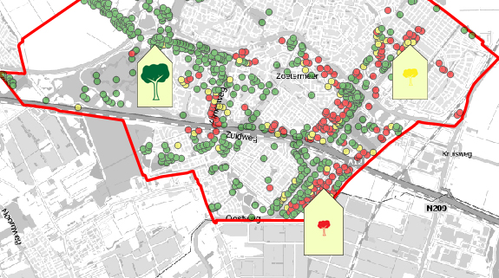
Maptips
15-01-2016 | GEO1005

Slide 7
15-01-2016 | GEO1005
Data
Background: BRT backgroundmap (WMTS)
Buildings: Top50NL (Polygon Shapefile)
Municipality Boundaries: BGA (Polygon Shapefile)
Green area's: OSM (Polygon Shapefile)

Slide 8
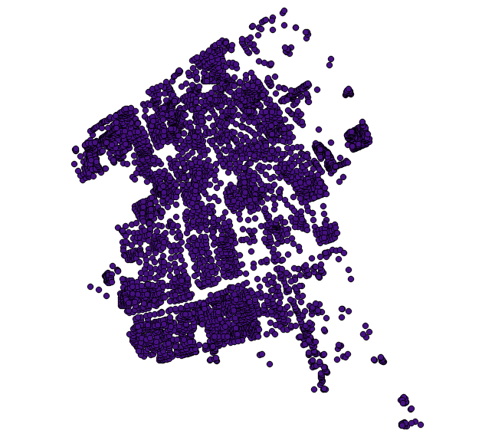
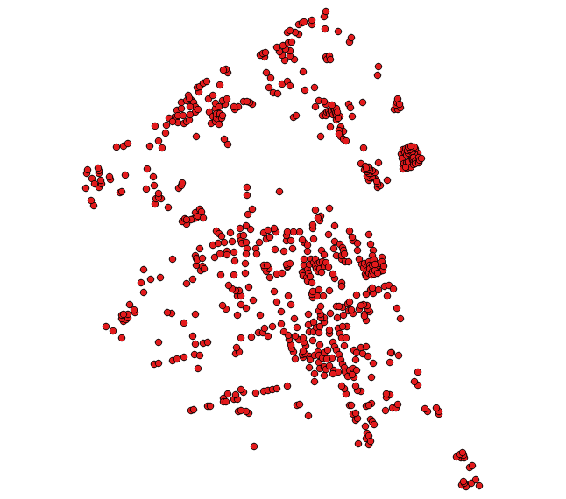
15-01-2016 | GEO1005
Building points
Generalised housing block points from Top50NL polygons (no mixed function buildings)

Slide 9
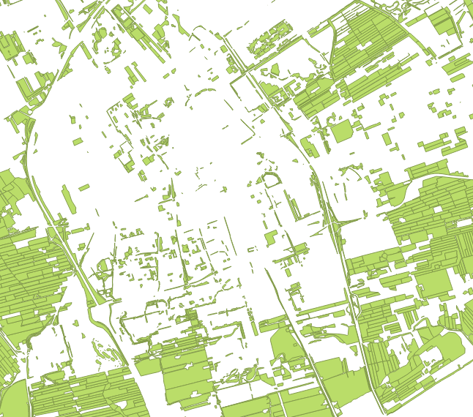
15-01-2016 | GEO1005
Green areas

Slide 10
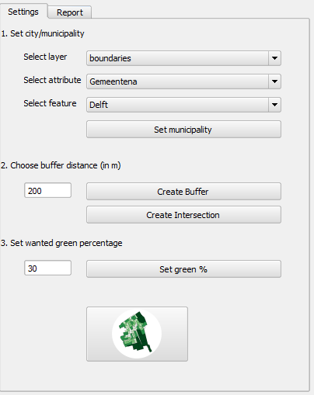
15-01-2016 | GEO1005
The interface (UI)
Set the working area
Set the traveldistance
Set the threshold and generate outputfile

Slide 11
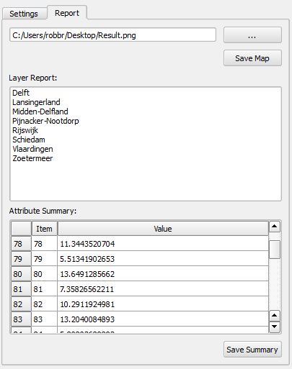
15-01-2016 | GEO1005
The interface (UI)
Export the map (PNG)
Select attribute summary
Check and export the attribute summary (CSV)

Slide 12
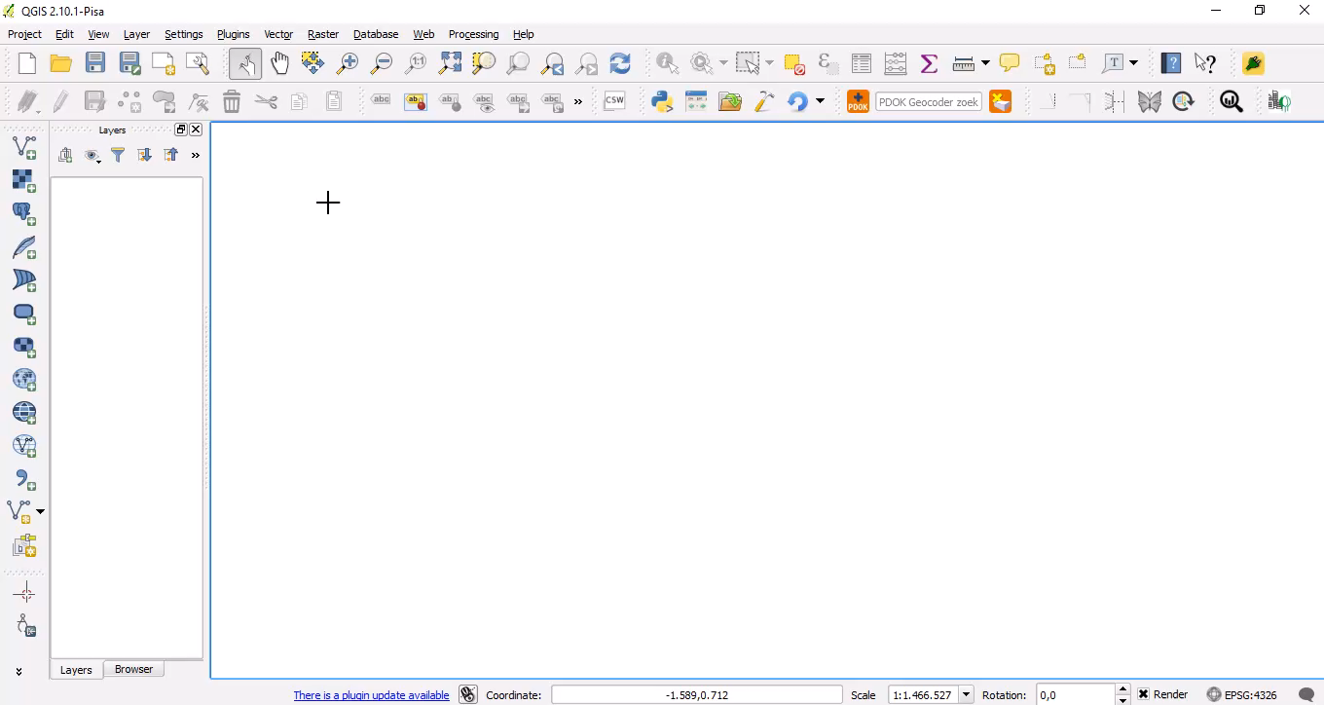
15-01-2016 | GEO1005
Demo: Creating a map

Slide 13
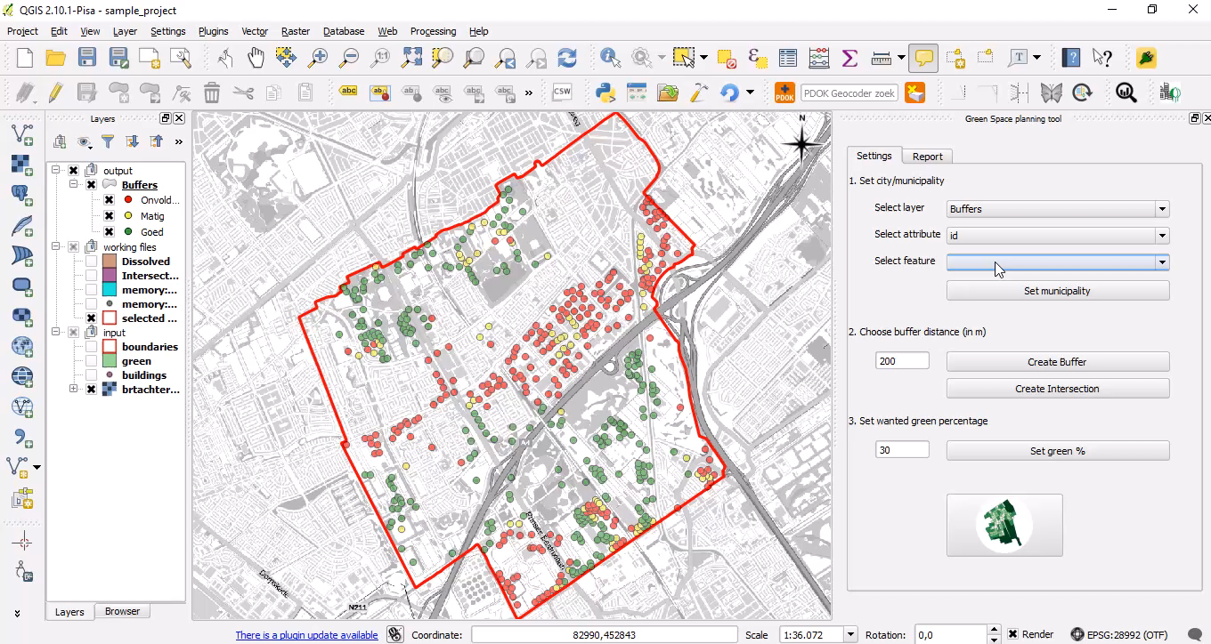
15-01-2016 | GEO1005
Demo: Saving the result

Slide 14
15-01-2016 | GEO1005
Questions and peer review

